Slide 1

S.Y. Mini Project Presentation
“PriceBite - Find Best Price for Every Bite”
Guide: Prof. Pankaj Deshmukh
Group No: 9
Aryan Deshmukh (22)
Needhi Ganatra (27)
Siddhesh Girde (28)
Department of AI&DS, K.J. Somaiya Institute of Technology, Sion, Mumbai 400022
29/9/2025
26/6/2023

Slide 2

INTRODUCTION
This project involves the development of a web-based platform designed to compare food prices across various food delivery platforms such as Swiggy, Zomato, their own delivery app, and more.
29/9/2025
26/6/2023

Slide 3
Literature Survey
We observed people often pay different prices for same order.
Restaurants often list same item for different prices across platform due to different commission taken by platforms.
We can conclude that chains like Dominos and McDonalds offer lowest price on their own delivery platform.
29/9/2025
26/6/2023

Slide 4
Aim and objective
Develop a user-friendly tool that enables users to quickly compare food prices from different delivery services.
Ensure that the platform provides accurate and easy navigation.
Promote cost-effective decision-making for consumers.
Provide transparency in pricing and help users choose the most affordable option.
29/9/2025
26/6/2023

Slide 5
Social Impact/Effect of Problem
1. Many users unknowingly overpay for food items due to lack of price visibility across platforms.
2. Our tool can help users become more aware of price differences, promoting smarter purchasing.
3. Supports budget-conscious individuals like students and low-income families by helping them get the best deal.
29/9/2025
26/6/2023

Slide 6
System Design
1. Frontend: JavaScript, HTML, CSS.
2. Backend: Java, C++
3. Database: SQL
29/9/2025
26/6/2023

Slide 7
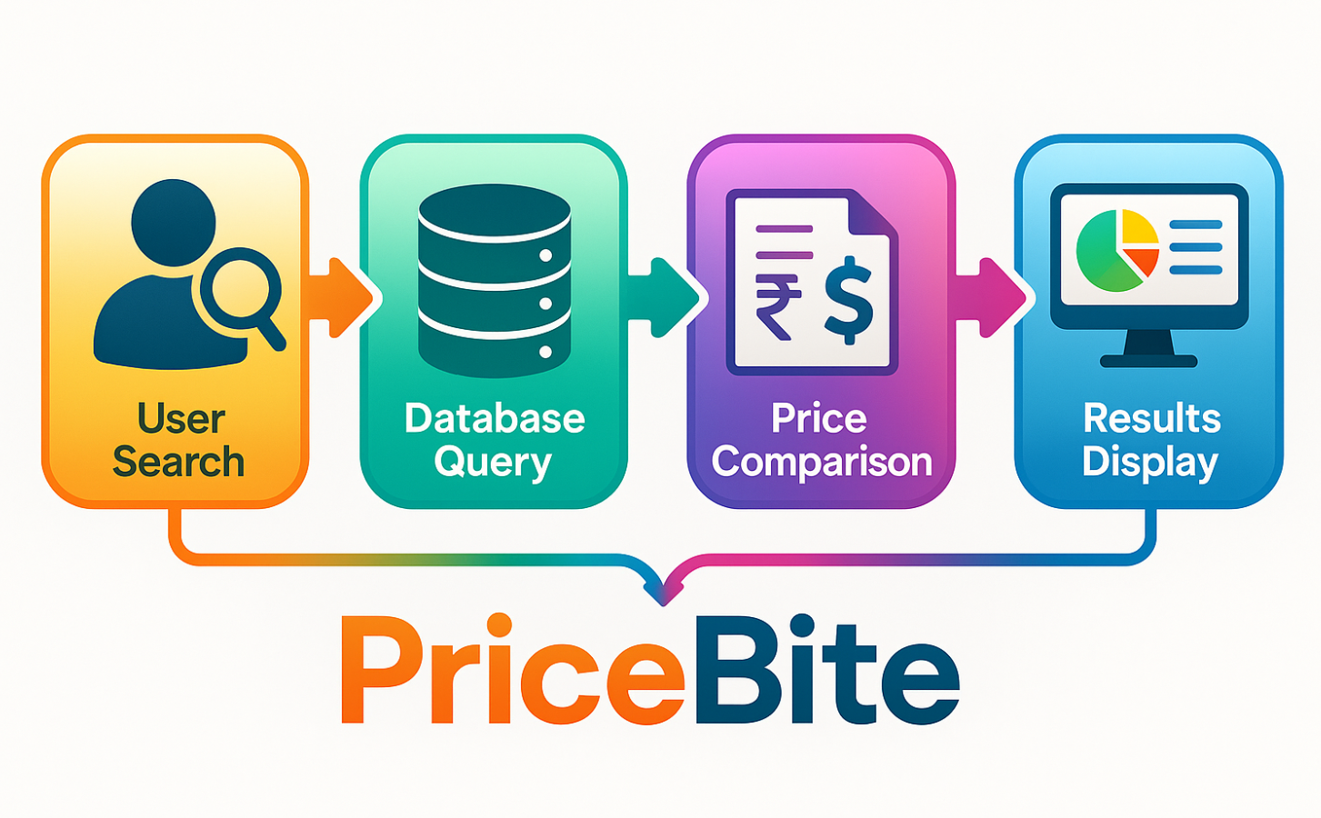
Block Diagram
29/9/2025
26/6/2023

Slide 8
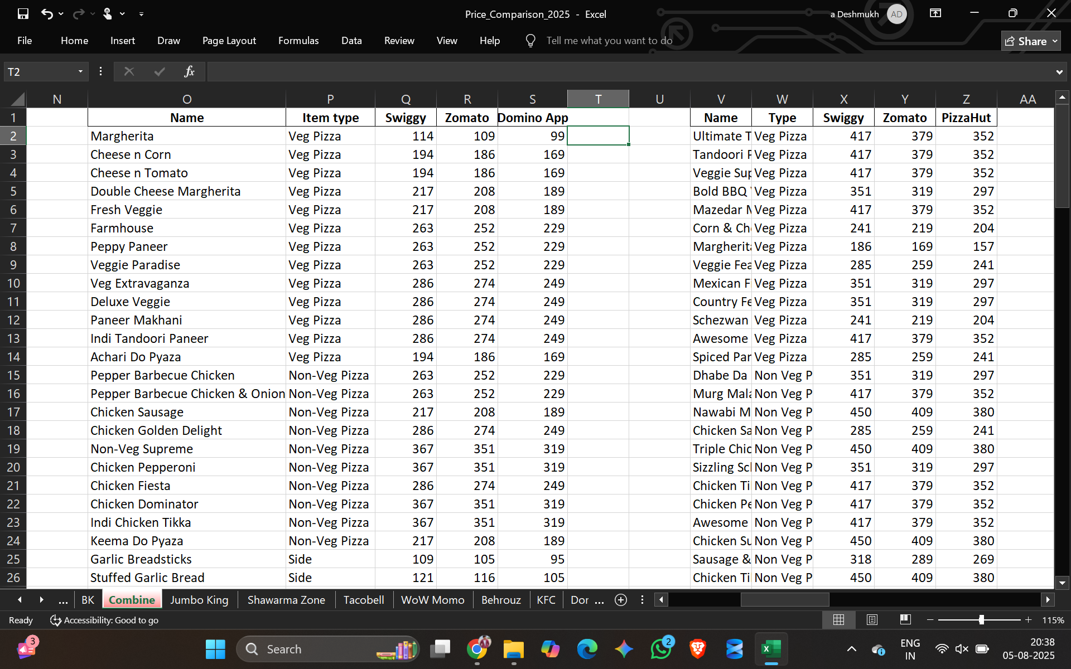
29/9/2025
26/6/2023

Slide 9
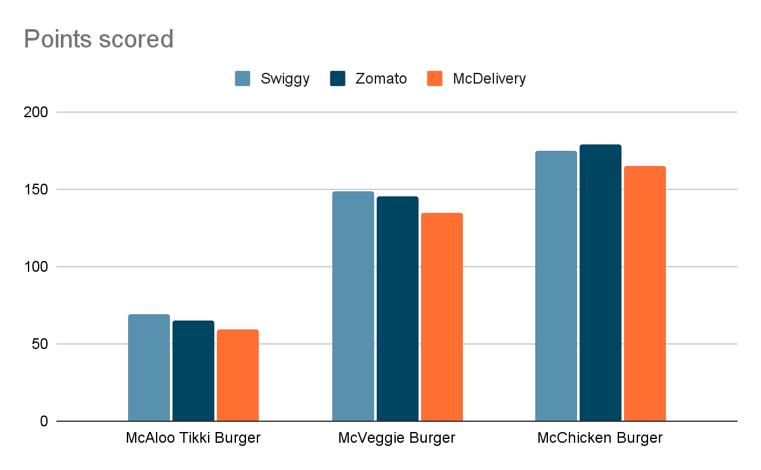
Results and Analysis
McAloo Tikki Burger | Burger | 69 | 65 | 59
McVeggie Burger | Burger | 149 | 145 | 135
McChicken Burger | Burger | 179 | 175 | 165
29/9/2025
26/6/2023

Slide 10
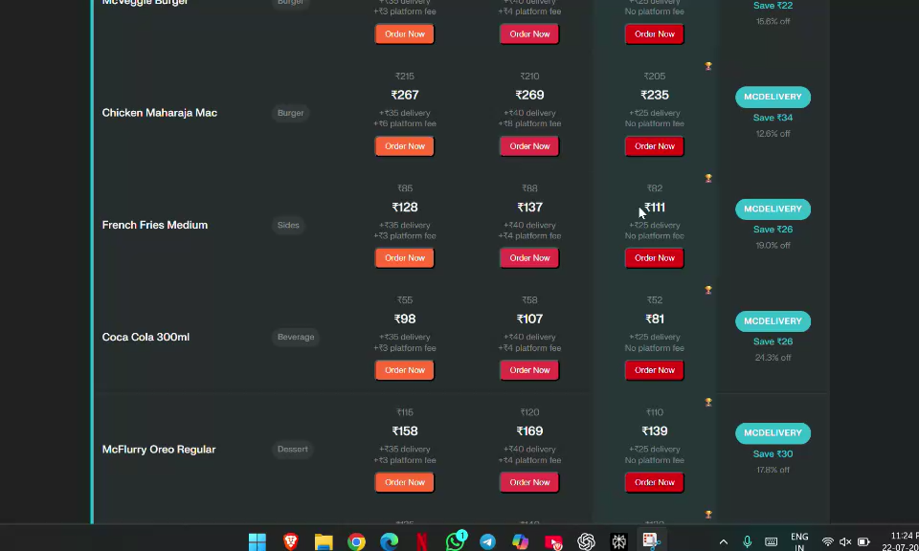

Slide 11
System Implementation
Our system is implemented using a combination of:
Frontend technologies for user interface
Backend logic for data processing
Static data collected from platforms
After the user has selected items we will provide redirect link to swiggy, Zomato, etc.
29/9/2025
26/6/2023

Slide 12
Conclusion
•It will save user’s time and efforts to find the cheapest option available across platforms.
29/9/2025
26/6/2023

Slide 13
References
•Swiggy, Zomato, McDelivery, Dominos, etc.
AI tools for fetching and analysing website data - Perplexity AI, ChatGPT
29/9/2025
26/6/2023

Slide 14
Thank You
29/9/2025
26/6/2023

